Slide 1


COMMENT
ANALYSIS
Presented by Zafer Mesut Bilen

Slide 2
TABLE OF
CONTENTS
01
04
Introduction
Conclusions
02
Methodology
03
Results

Slide 3
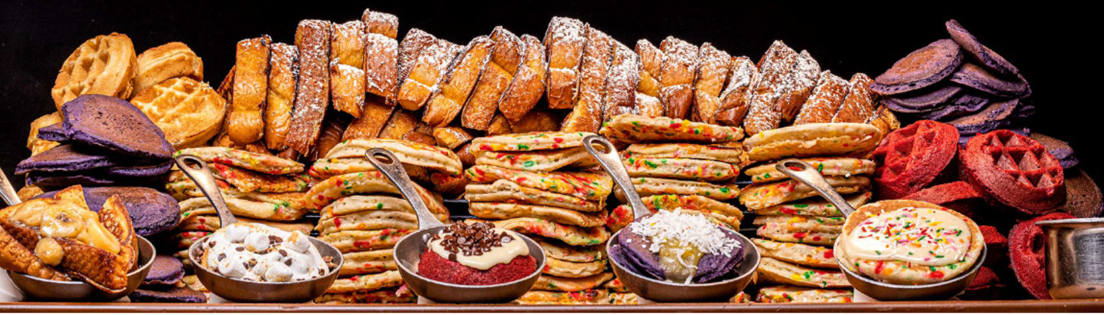
INTRODUCTION
Business Need
Solution
Objectives
Improving services and customers satisfy for Bacchanal Buffet.
Using ready dataset, Analyse Reviews, Customer’s Sentiment and provide suggestions.
Processing text data
NLP Supervised Classification
Sentiment Analsys

Slide 4
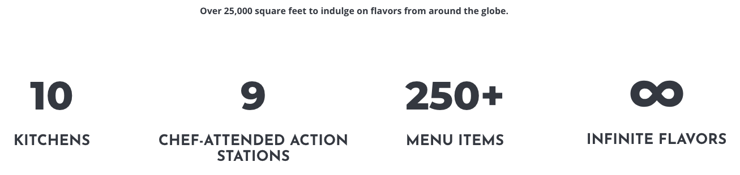
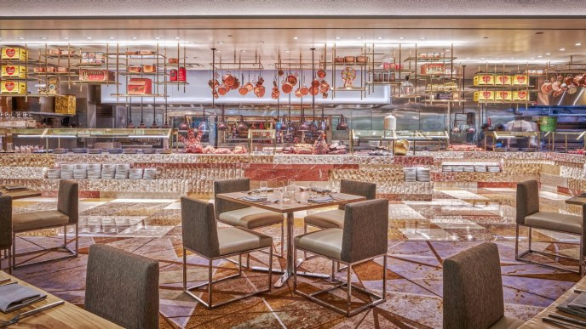
INFORMATION ABOUT THE COMPANY
FEAST YOUR EYES, FIRST
Dine in your element, in this elegant space at Caesars Palace Las Vegas hotel. The renovated Bacchanal Buffet dining room evokes its original nature concept, with glass and stone textures woven throughout. You’ll find these new spaces reminiscent of ice caves, mountains and more.

Slide 5





METHODOLOGY
Exploratory
Data Analysis
Data Acquire
Text Processing
Modelling
Evaluation

Slide 6


TOOLS
Data Manipulation
Visualisation
Pandas
NumpPy
Seaborn
Matplotlib
Modelling
NLP
Scikit Learn
NLTK
TextBlob
WordCloud

Slide 7
RESULTS
Text Processing
Adding Sentiment Features:
Convert Lower Case
1,2 —> Negative
3 —> Neutral
4,5 —> Positive
Detecting Language:
Removing non English (42 reviews)
Applying Stemming & Lemmatisation
Removing Characters:
Training with some Algorithms
numbers (1-9)
punctuation ()
new line (\n)

Slide 8
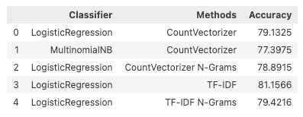
RESULTS

Slide 9
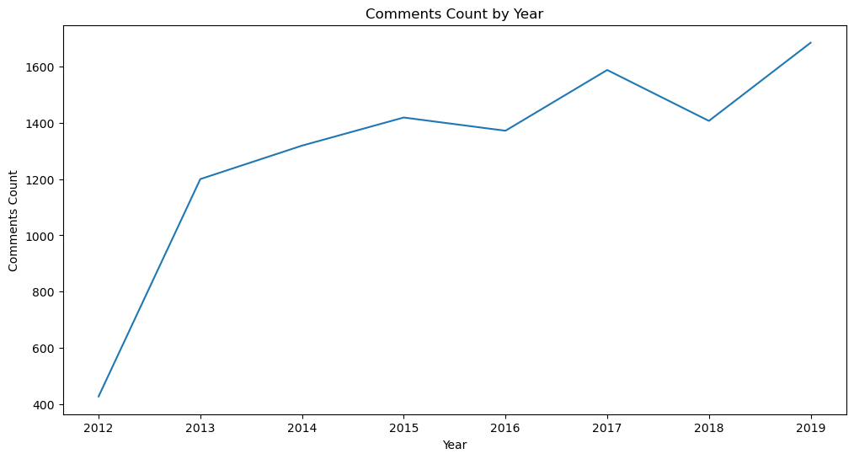
RESULTS

Slide 10
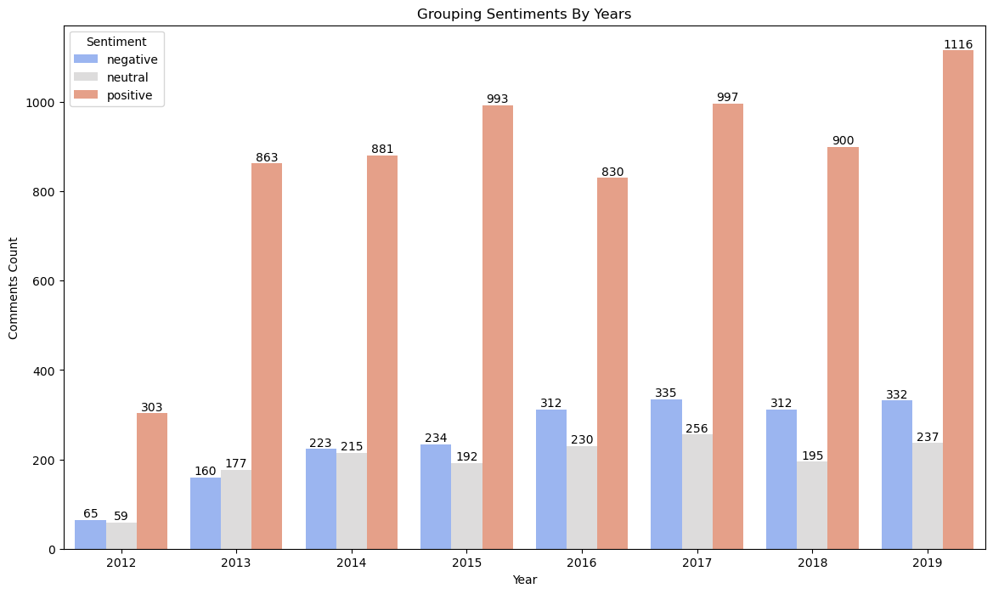
RESULTS

Slide 11
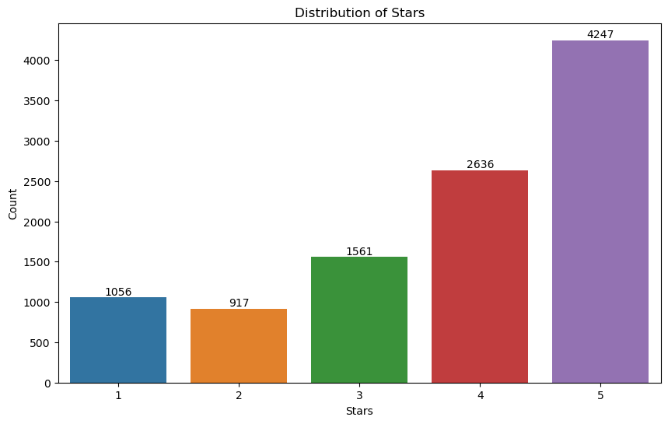
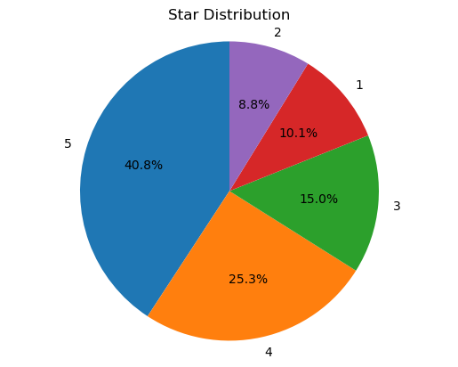
RESULTS

Slide 12
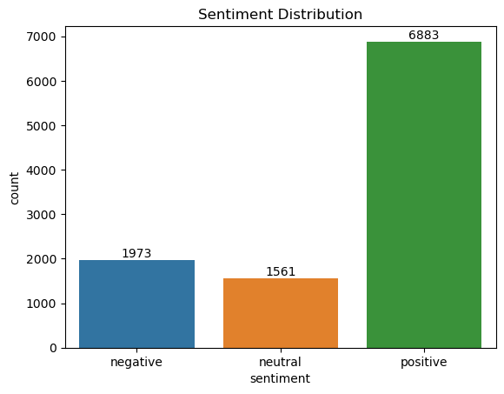
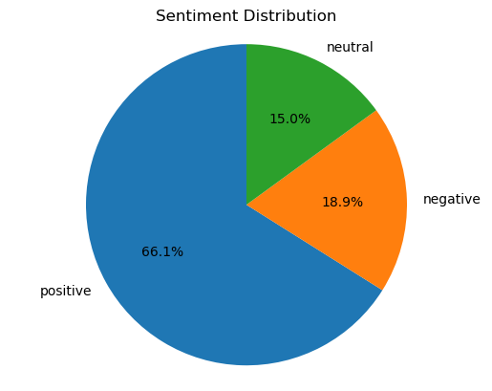
RESULTS

Slide 13
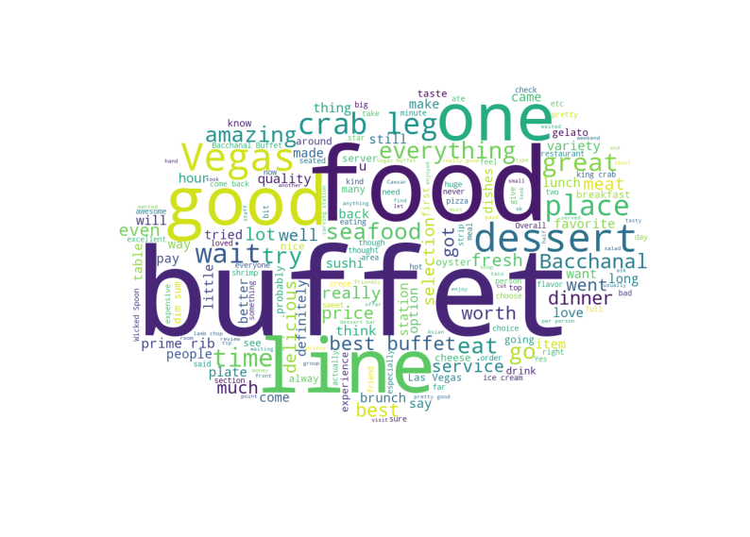
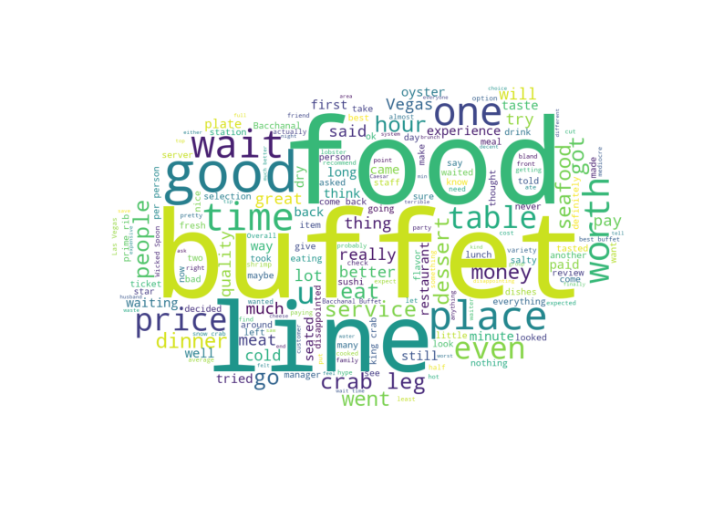
RESULTS
Positive Comments
Negative
Comments

Slide 14
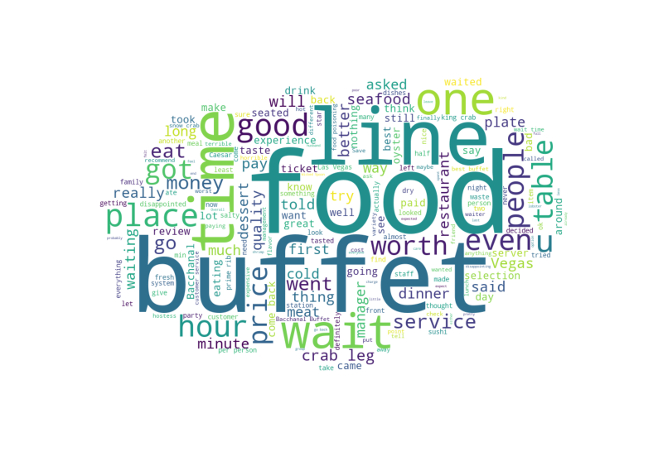
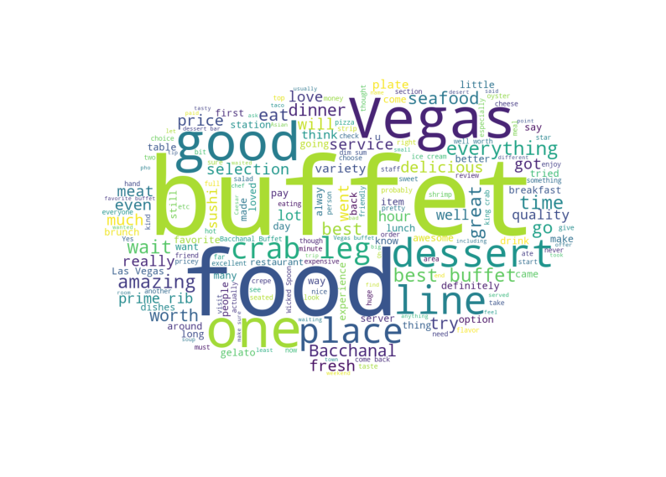
RESULTS
1 Star
Comments
5 Star
Comments

Slide 15
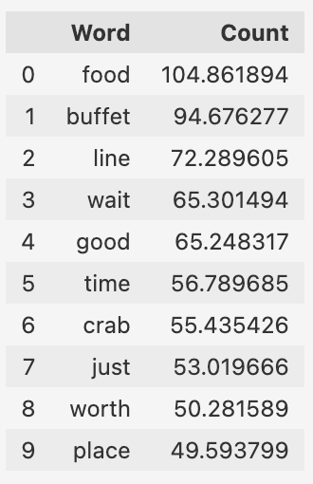
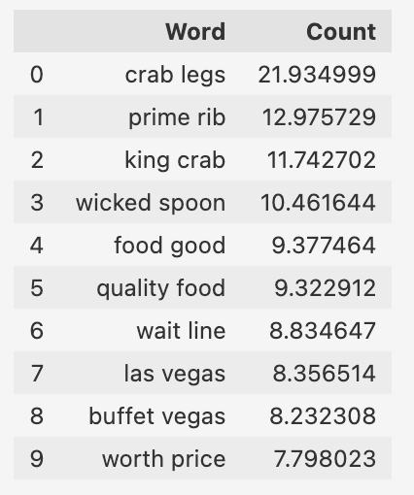
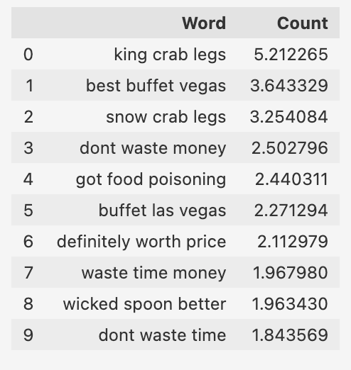
CONCLUSIONS
Negative Words
Negative 2 Words
Negative 3 Words

Slide 16
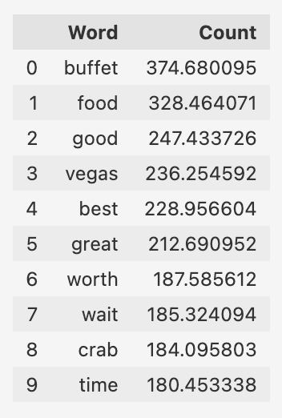
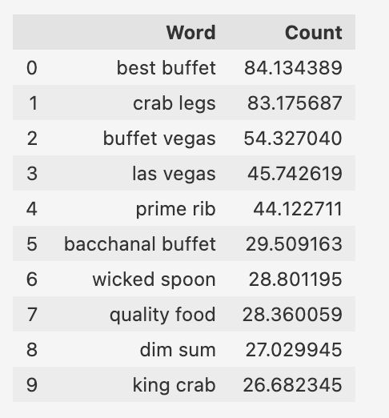
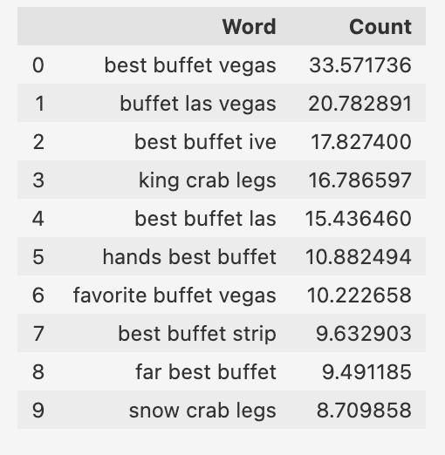
CONCLUSIONS
Positive Words
Positive 2 Words
Positive 3 Words

